Slide 1
Random Forest Classifier for
Predicting Movie Genres
David Wright
CPSC 4383: Artificial Intelligence
Fall 2024
Dr Milanova

Slide 2
Introduction
Project Goals and Data
Preprocessing
The Model
Hyperparameters and Other Factors
Results
Conclusion

Slide 3
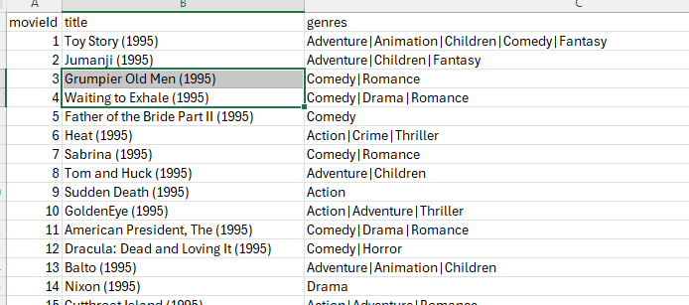
Project Goals and Data
Goals:
Develop a Random Forest Classifier
Predict the genre of movie base on its title
Present evaluation metrics including:
Accuracy Score
Precision
Recall
F1 Score
- Plot importance of features in predicting genre
The data:
~65k movies
Title with year
Genres separated by a ‘|’

Slide 4
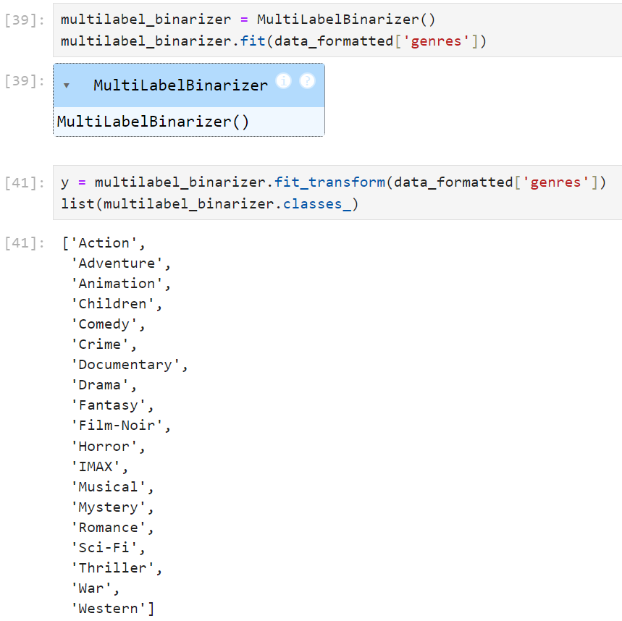
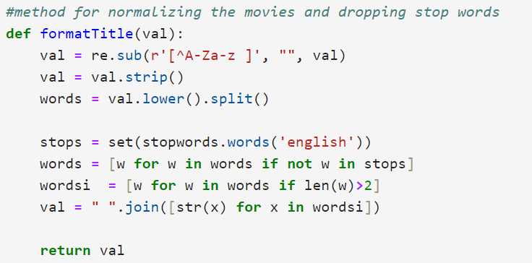
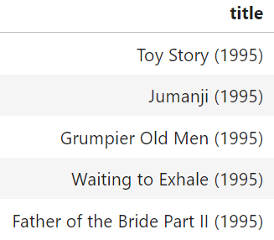
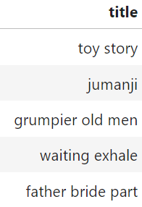
Preprocessing
No genre listed: instant drop
Lost ~5k movies
Method to format titles
Remove non-letters and extraneous spaces
Everything lower case
Remove stop words
Remove words with less than 3 letters
Used a Multi-Label Binarizer
For one-hot encoding of the genres
First had to split the genre strings

Slide 5
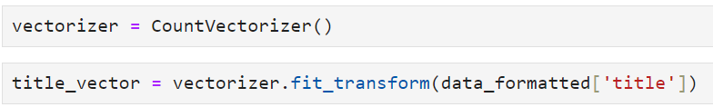
Preprocessing
Count Vectorizer for the titles
Train/Test split
- Test size .2

Slide 6
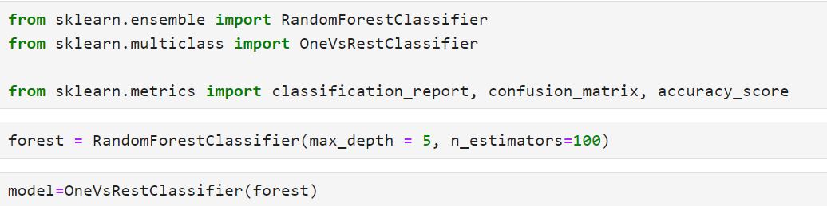
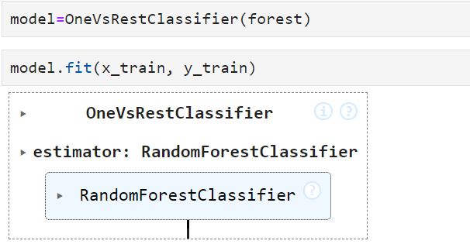
The Model
Random Forest Classifier
Provided < 10% accuracy
Low F1 score
Essentially really bad
One vs Rest Classifier

Slide 7


Hyperparameters and Other Factors
Random Forest
Max depth: 5
N_estimators: 100 minimum
Min_samples_split vs min_samples leaf: Default
Max_features: Default
One vs Rest Classifier
model.predict
model.predict_proba
Prediction acceptance range

Slide 8
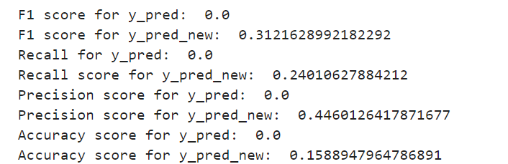
Results
Answer: No a movie title is decidedly NOT a good predictor of what genre the movie will be
With default settings: 11% accuracy score
Hyperparameter tuning (best results):
N_estimators = 300
Max_depth = 10
min_samples_split = 5
Max_feature = log2

Slide 9
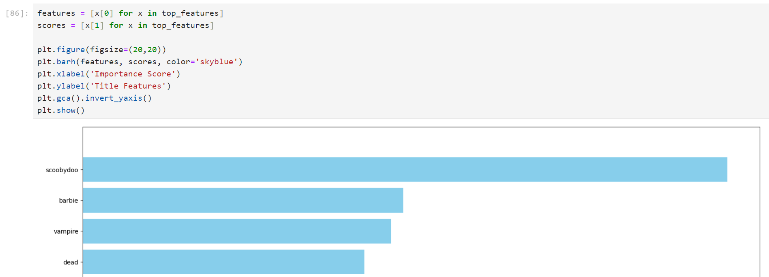
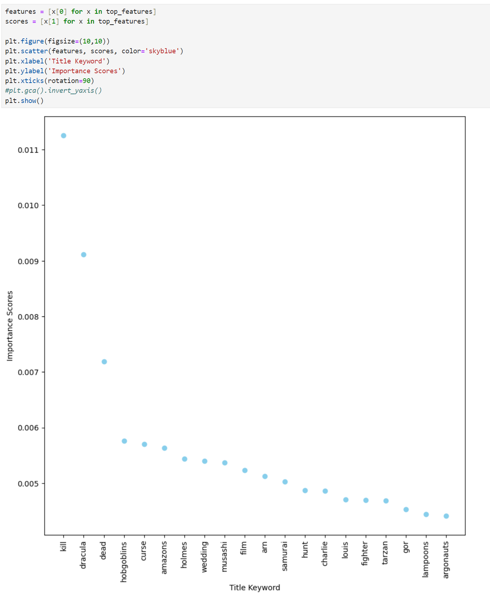
Word Importance
Based on single random forest
Can be different depending on the training

Slide 10
Conclusion
Project Goals and Data
Preprocessing
The Model
Hyperparameters
Results
Conclusion

